Slide 1
Creating an Account
Creating Generative AI Applications

Slide 2

Go to https://openai.com/
Click on Signup in the top right corner

Slide 3
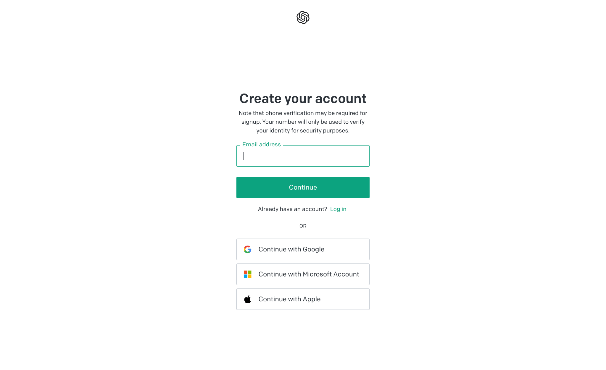
Create an account
Choose any of the available options

Slide 4
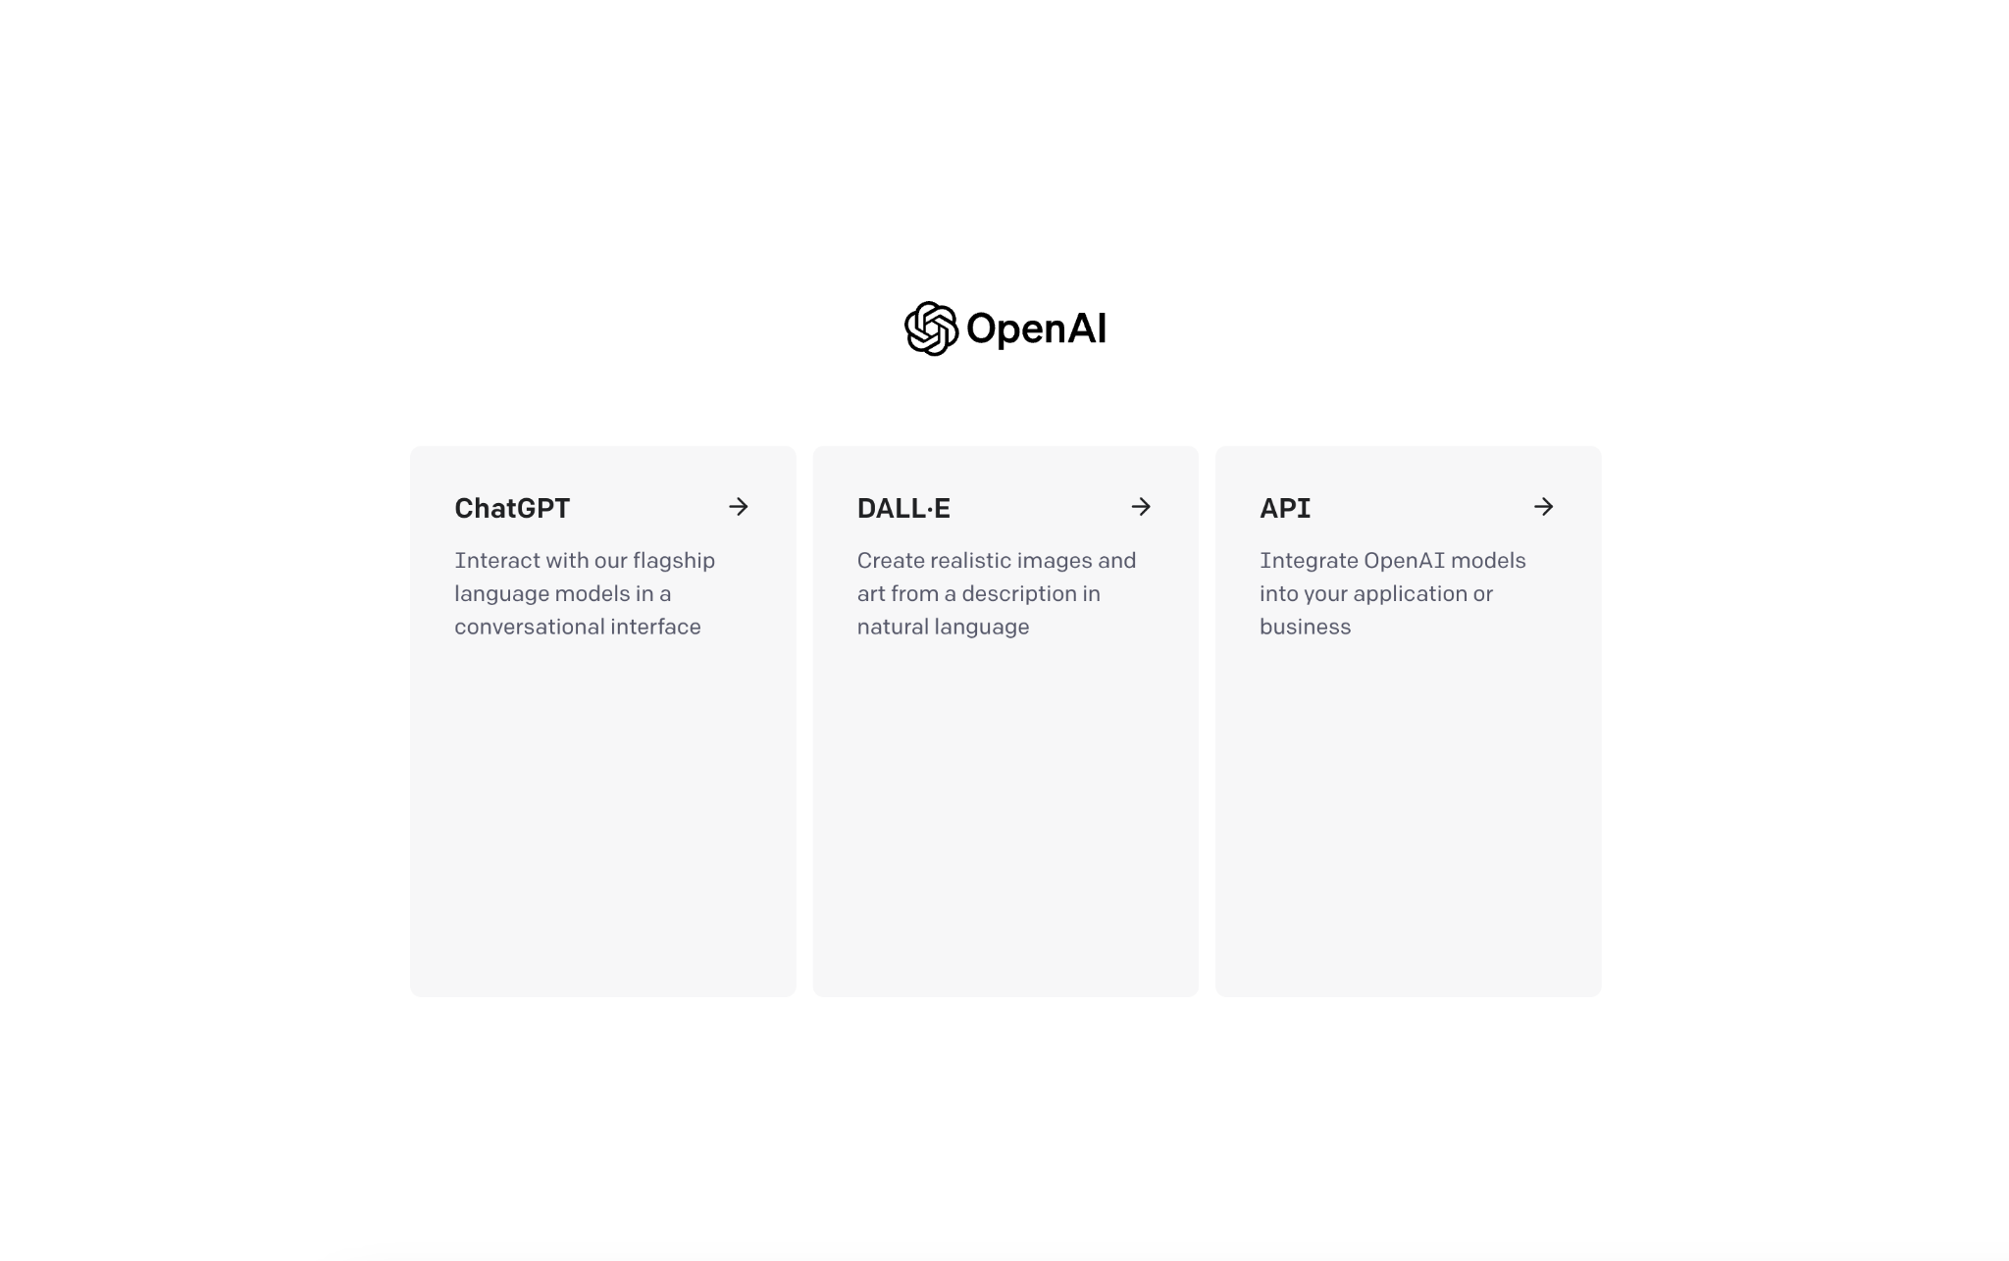
Choose API

Slide 5
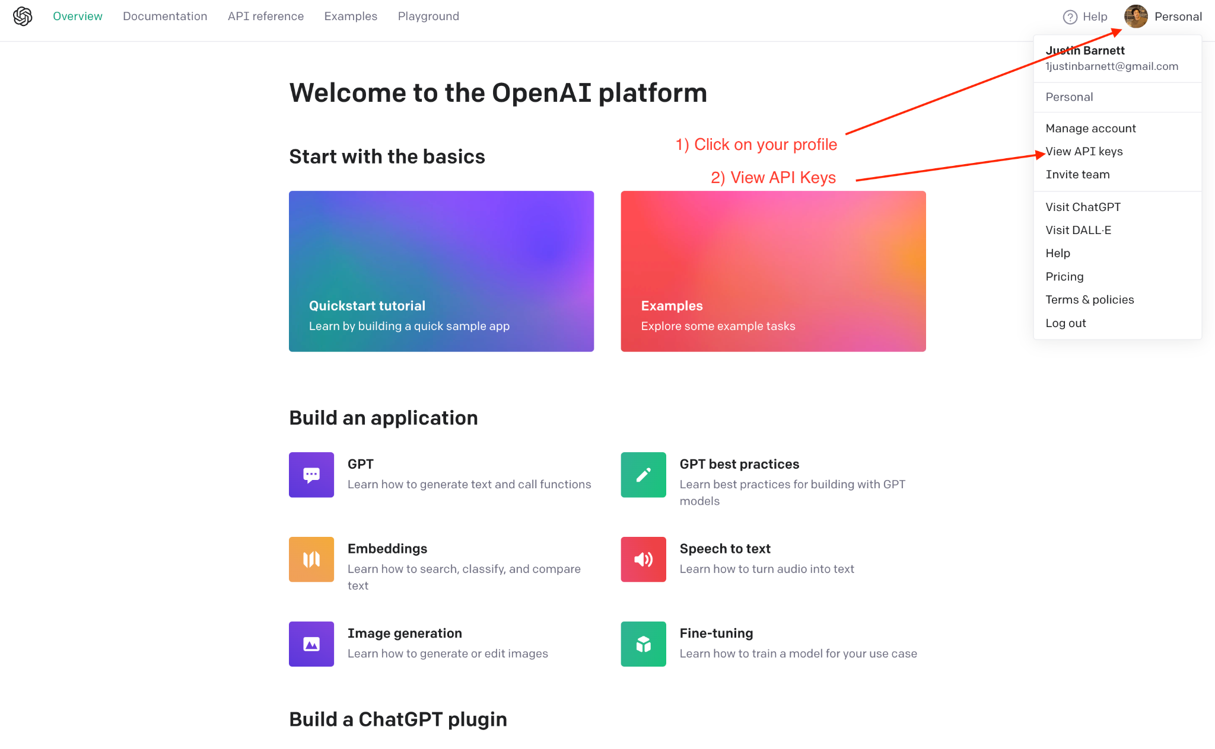
Find the API Keys
Click on the profile button on the top right corner
Click on View API Keys

Slide 6
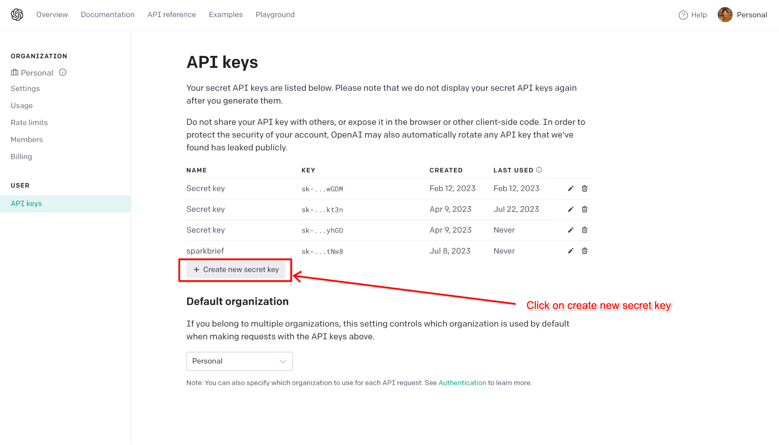
Create a new secret key

Slide 7
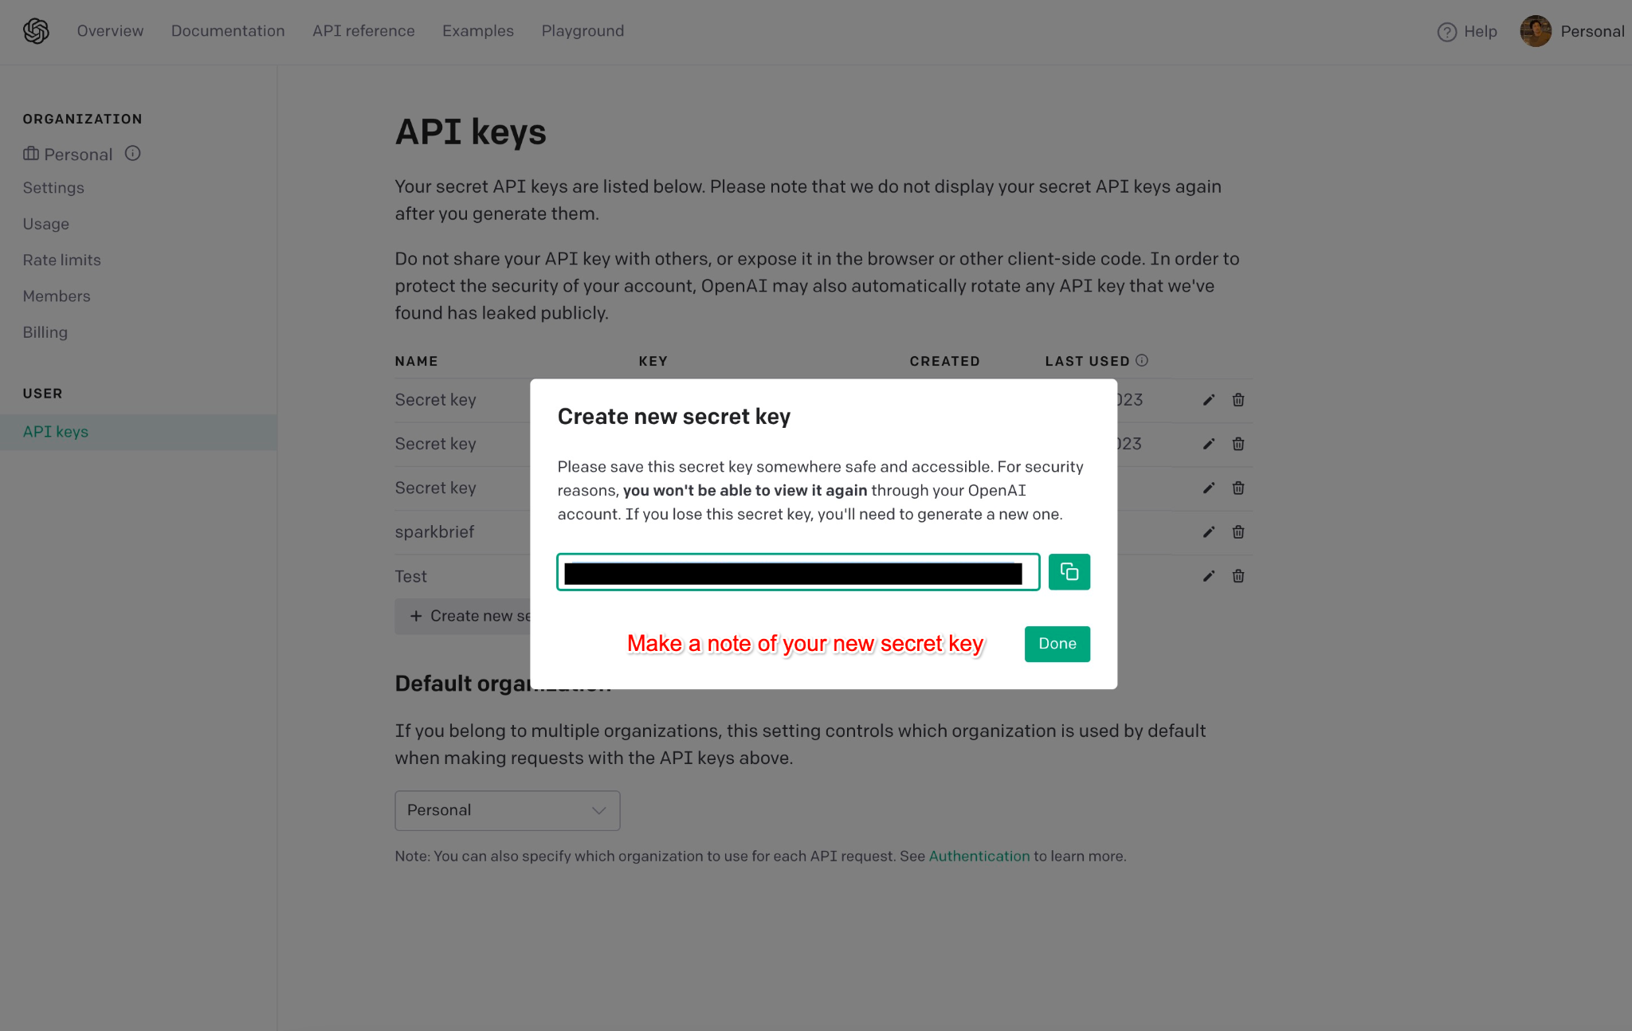
Make a note of your new secret key

